Slide 1
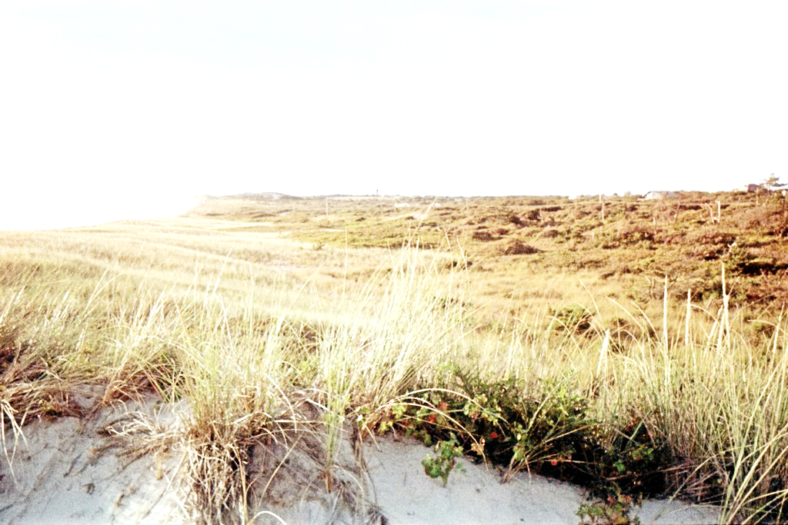
Total Maximum Daily Loads (TMDL)
Restoring and Preserving Water Quality through
Nitrogen Control Strategies
Chilmark Pond
Estuarine System
MassDEP
April 2, 2019
Notes:
Introductions
Taking public comments on the Draft Total Maximum Daily Load (TMDL) Reports for tisbury great pond and black point pond watersheds
Agenda
1. Give background on the Massachusetts estuaries project and technical report that is the basis for the TMDL
2. Talk more specifically on the TMDLs 3. And allow time for questions on the TMDLs and future of nitrogen management
The draft TMDL was distributed this summer for municipal review and comment. It is available online . A few executive summaries are available here.

Slide 2
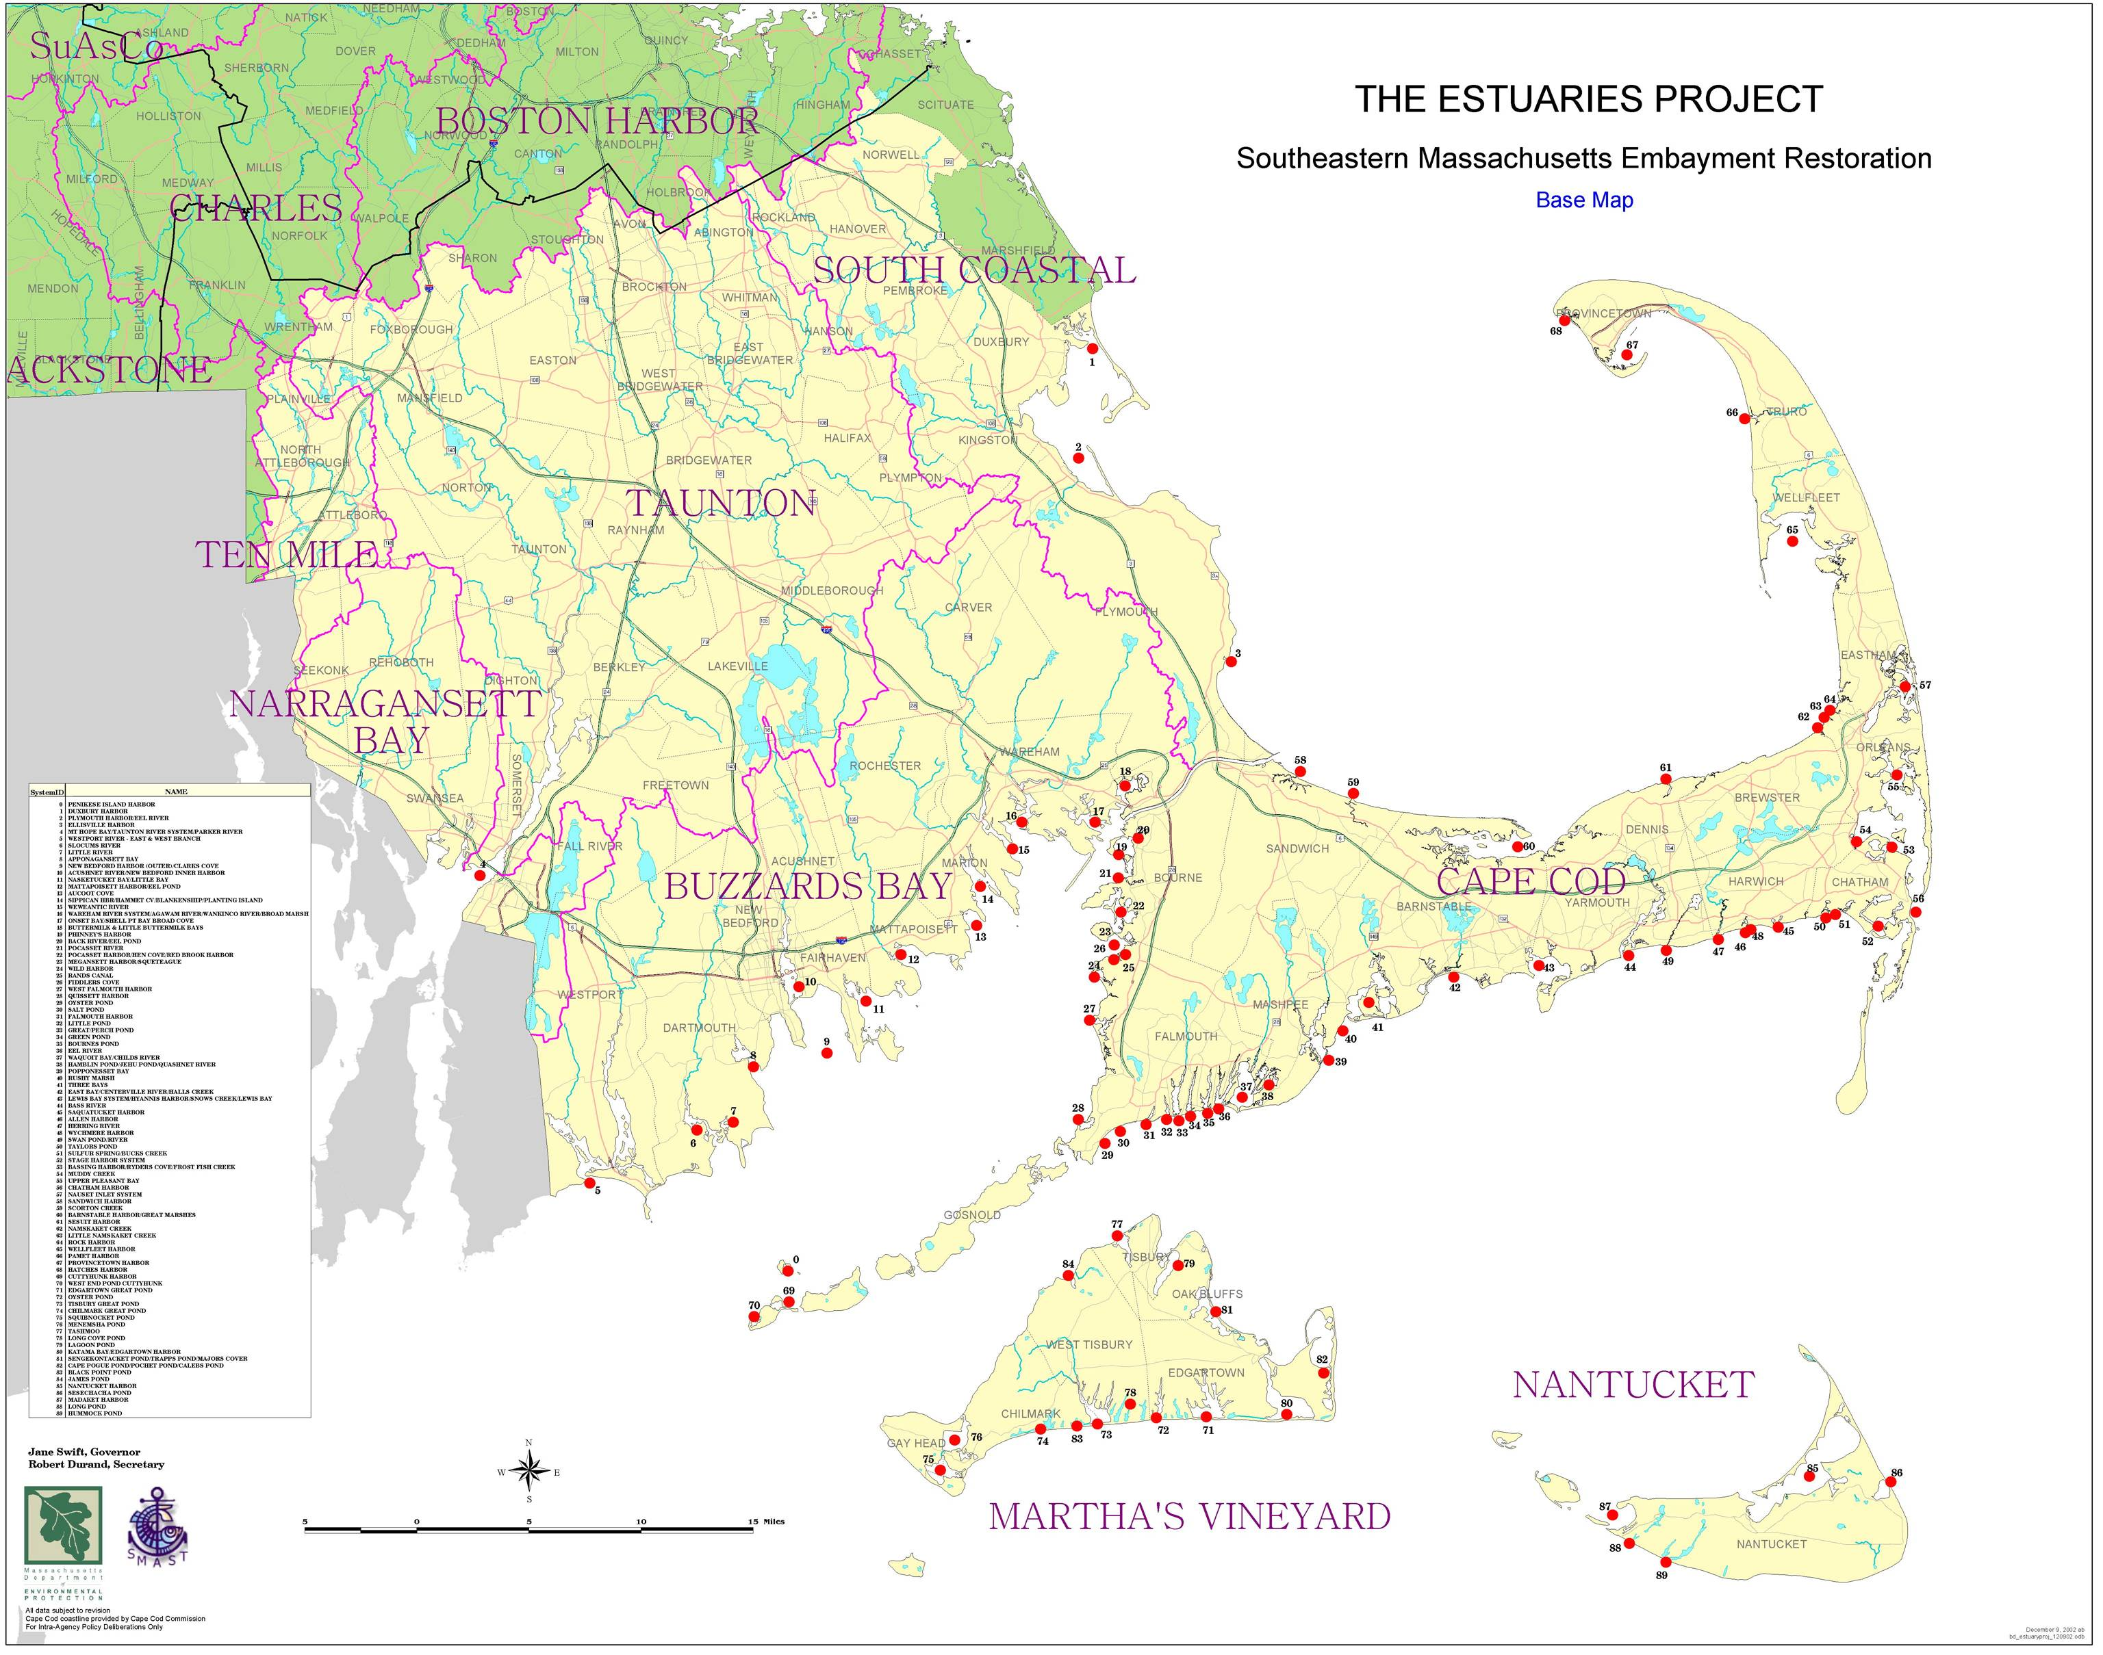
The Massachusetts
Estuaries Project
(MEP)
Collect data and evaluate 70 embayments
Science based recommendations to improve water quality
Notes:
Many of you are already familiar with the Massachusetts Estuaries Project
Briefly,
The Massachusetts Estuaries Project or MEP is a collaborative effort to Provide Communities with Estuary specific, science-based recommendations to improve water and habitat quality to 70 embayments using a linked watershed model.
Slide is a map of the 70 communities within the project- About 54 reports (draft or final) have been prepared so far.
roughly 89 embayment systems in Southeastern MA including Cape Cod, Buzzards Bay, and the Islands of Nantucket and Martha’s Vineyard.

Slide 3
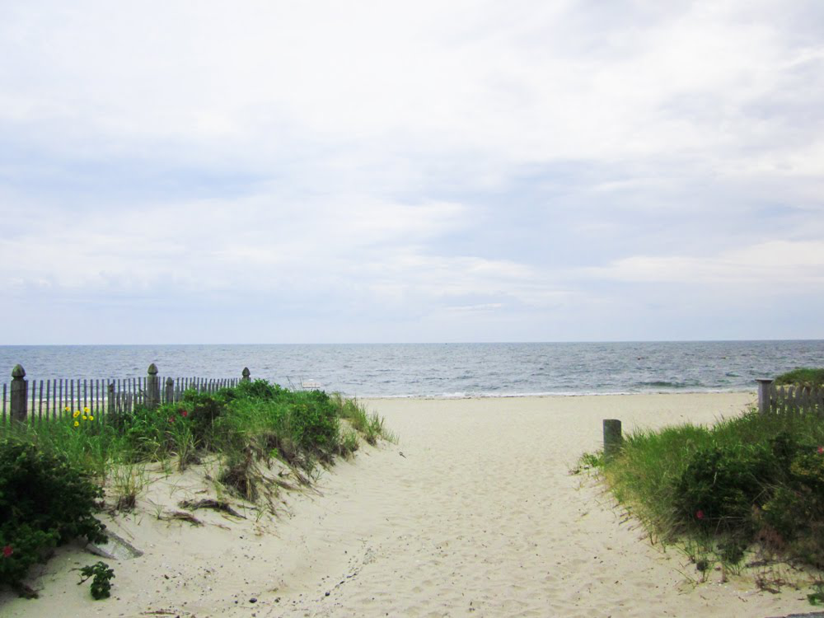
Information Sources and Participants
Town of Chilmark
UMASS Dartmouth School of Marine Science & Technology (SMAST)
Applied Coastal Research
and Engineering, Inc.
Martha’s Vineyard Commission
USGS
US EPA
MA Division of Marine Fisheries
MassDEP
Notes:
Here is a list of collaborators.
MassDEP, the University of Massachusetts School of Marine Science and Technology, the Cape Cod Commission, the U.S. Environmental Protection Agency, the US Geological Survey, and the Executive Office of Energy and Environmental Affairs, as well as municipalities and watershed associations in southeastern Massachusetts,
.

Slide 4

Massachusetts Estuary Project
Integrates data on water quality with nutrient loading and hydrodynamics
Data collected:
2003-2005, 2010, 2012
SMAST completed Technical Report in 2015
Technical Report becomes basis for TMDL
Notes:
MEP uses a linked watershed embayment approach – this means it integrates the data on water quality, nutrient loading, and hydrodynamics to model the impact of nitrogen loads on estuaries.
Water quality data, was collected by SMAST and the Town of chilmark and riparian owners 2003-2005, 2010 2012
SMAST – School for Marine science and technology, prepares the technical report, which was completed in 2015
This report provides DEP with the scientific basis for the TMDLs

Slide 5
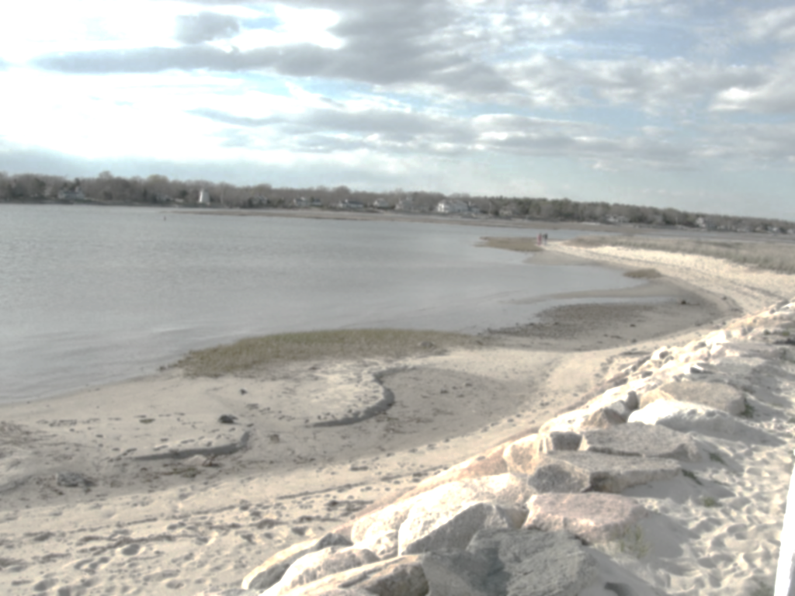
MEP Goals
Determine: Nitrogen Loading Limits that are specific to individual estuarine systems in Southeastern Massachusetts
Provide: Nitrogen Management Strategies to achieve these limits
Notes:
The goal of the MEP is to Determine nitrogen limits and recommends strategies to meet those limits
The Technical Report identifies potential nitrogen reduction approaches to guide wastewater management decisions..
So the project goals are to
Evaluate the water quality status of each embayment system
Develop protective nitrogen thresholds and loading limits for each embayment
And provide a consistent methodology and tools to investigate and define acceptable nitrogen remediation strategies.
It should also be noted that although all potential sources of nitrogen were evaluated during this process the largest contributors were septic systems

Slide 6
The Process
Water Quality Data - min 3 years
Linked Model & Report:
  Hydrodynamic Model
  Nitrogen Loading
  Water Quality Model
  Thresholds Analysis
Watershed Delineation
Land Use Data
CWMP & more model runs
TMDL Development
Implementation!
Notes:
Developing a the tech report and subsequent TMDL for an estuary requires delineating watersheds, and collecting 3 years of water quality data and land use data. This information comes from communities, regional planning groups, and state and local monitoring programs.
Data Collection - minimum 3 years baseline to get into the process followed by at least 1 year of intensive surveys (hydrodynamics, loadings, benthic, sediments) (Towns and SMAST)
Watershed Delineation: In this case groundwater. Each subwatershed had to be delineated to each embayment so we could identify contribution not only to each estuary but also sub-estuary.
Land Use: CCCommission digital parcel and land use assessors data from 200– land use was delineated not only for each subwatershed but parcel by parcel, Included water budget. Towns provide detailed parcel data including water withdrawal, discharges, and septic systems.
Model: Linked model approach using land use model for loadings followed by RMA1 and RMA2 ACOE models for hydrodynamics and water quality
Threshold analysis: Reference condition approach (based on biological and chemical data) to identify impacted and non-impacted areas and to identify a target at the sentinel site for each.
TMDL development: to determine the N load necessary to maintain acceptable habitat quality thru out embayment system
CWMP: Comprehensive Wastewater Management Plans: planning process for towns to evaluate potential alternatives to meet the TMDL targets – can have the model run to evaluate other N load reduction scenarios

Slide 7
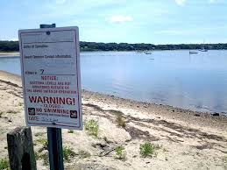
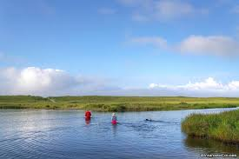
Tech Report Characterizes Present Conditions
  Nitrogen Loading to Groundwater
  Groundwater Flow to Estuaries
  Estuary Circulation, Tides & Currents
  Nitrogen Concentrations in Estuaries
  Estuary Habitat Health
Notes:
The MEP technical study characterized these elements for each estuary in order to determine present conditions.
Habitat health (assesses specifically based on eelgrass, chlorophyll, macroalgae, benthic macroinvertebrates, dissolved oxygen)
1. Measure the concentration
2. Calculate flow and load (land use and water use on a parcel by parcel basis)
3. Measure streamflow
4. Hydrodynamic modeling

Slide 8
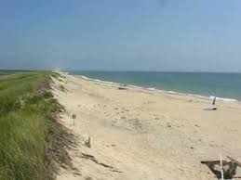
SMAST’s Linked Model Establishes Target Threshold Nitrogen Concentration:
Is the average nitrogen concentration in the water column that will support the habitat quality goal.
Notes:
The Technical Report establishes a nitrogen threshold for each estuary. This establishes the maximum amount of nitrogen allowable in the watershed on an annual basis in order to maintain the health of the estuary.
Target N concentration is selected based on an evaluation of similar estuary systems in the region (in terms of depth, morphology, flow, configuration, etc.) with water quality N levels known to support eelgrass and/or benthic macroinvertebrates.
This is a key element of the tech report and of establishing the TMDL is the threshold concentration.
This target nitrogen concentration is applied to a specific site in the estuary called the sentinel station

Slide 9

Sentinel Station
Located at or near a long term monitoring station
Location based on historic eel grass and macroinvertebrate information
Target threshold nitrogen concentration applied at sentinel station
Notes:
To restore the estuary system, the target threshold nitrogen concentration will need to be achieved at the sentinel station.
Later slides show location of sentinel station for each embayment.
Once the sentinel site and its target nitrogen level are determined, the MEP study models nitrogen loads until the targeted nitrogen concentration is achieved.
For Chilmark Great Pond the restoration target was based on restoring benthic in fauna habitat

Slide 10

Achieving the Target Threshold N Concentration at the Sentinel Station will result in:
Possible Eelgrass Restoration
Reduced Algal Blooms
Improved Dissolved
Oxygen Concentration
Healthy Benthic Animal
Assemblages
Notes:
By lowering the level of nitrogen enrichment at the sentinel station it will also lower nitrogen levels throughout the estuary with the parallel effect of improving benthic habitats in the estuary
With the threshold concentration established, nitrogen limits can be set in order to achieve the nitrogen criteria in the water column. DEP uses the threshold concentration and nitrogen load limits to form the TMDL.

Slide 11
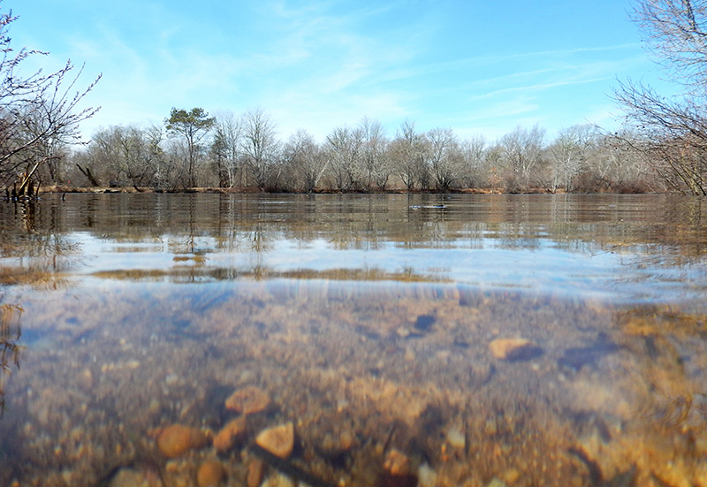
EPA requires states to
set limits on pollutants
Total Maximum Daily Load
(TMDL)
Notes:
The federal Clean Water Act requires all states to identify waterbodies that do not meet state water quality standards and develop TMDLs for them.
There are statewide water quality standards for a variety of uses such as drinking water, fishing, swimming and healthy ecosystems for plants and animals. The TMDLs ensure that waters are preserved and restored for those uses.
Federal Clean Water Act Section 303d and EPA’s Water Quality Planning and Management Regulations (40 CFR Part 130)

Slide 12
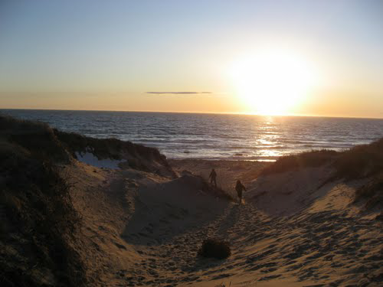

Total Maximum Daily Load
Maximum amount of a pollutant that can enter a water body and still meet water quality standards
Notes:
Official definition of TMDL. Another way to look at it is as a pollution budget for the waterbody.
A TMDL is the sum of loads that are allowable from all contributing point and nonpoint sources of pollution. Point sources are primarily wastewater treatment plants that discharge to surface waters or groundwater. Nonpoint sources include septic systems, stormwater discharges via runoff over the land surface, and fertilizer runoff from lawns and golf courses.
In most cases for saltwater waterbodies the limiting or critical nutrient in controlling excessive nuisance plant growth (usually algae, periphyton (attached to surfaces) or phytoplankton (drifting or floating))

Slide 13
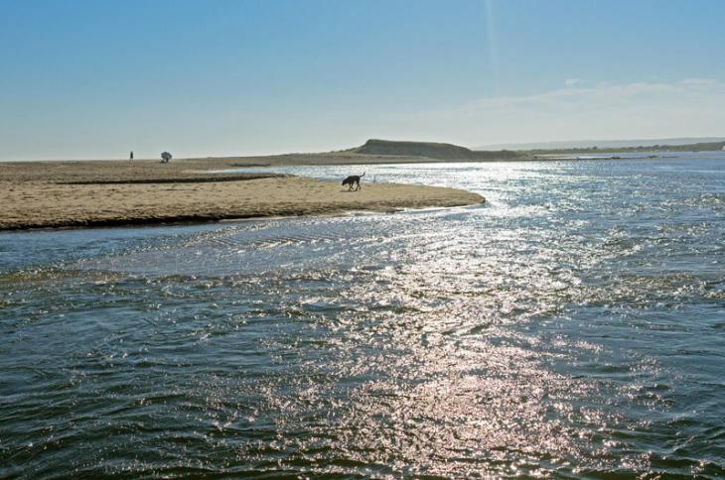
TMDL for Chilmark Pond Embayment System
Based on the MEP Technical Report
Documents the basis for the TMDL number
Establishes a nutrient loading threshold which will restore water quality and benthic habitat and support eelgrass.
Notes:
The TMDL is based on the MEP tech report. The TMDL sets the loading to the threshold which will restore benthic infauna habitat throughout Chilmark pond and simultaneously attempt to restore a modest level of eelgrass habitat within the main basin which has been nonexistent over the past several decades.

Slide 14
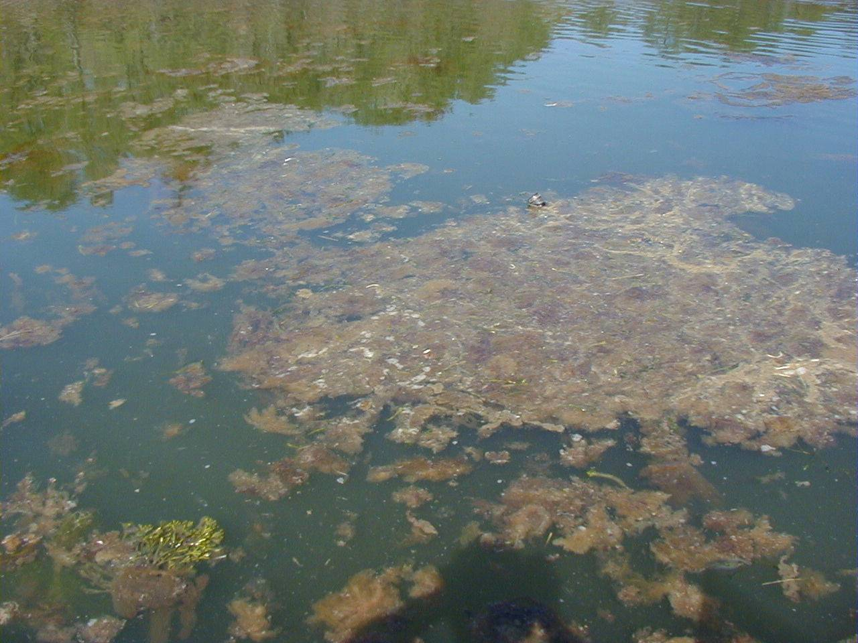
Why do we need TMDLs for Estuaries?
Declining coastal habitat quality due to
increased nitrogen loading resulting from
changes in watershed land uses
Notes:
This problem is common throughout coastal Massachusetts and it has been recently documented by the MEP studies in all of the estuarine systems being discussed today as well
Most southeastern Massachusetts estuaries are being impacted by excessive loads of nitrogen. Water quality is getting worse, and many estuaries do not meet the Massachusetts Water Quality Standards. Rapid population growth in the area has resulted in more nitrogen than estuaries can accept, causing poor water quality

Slide 15
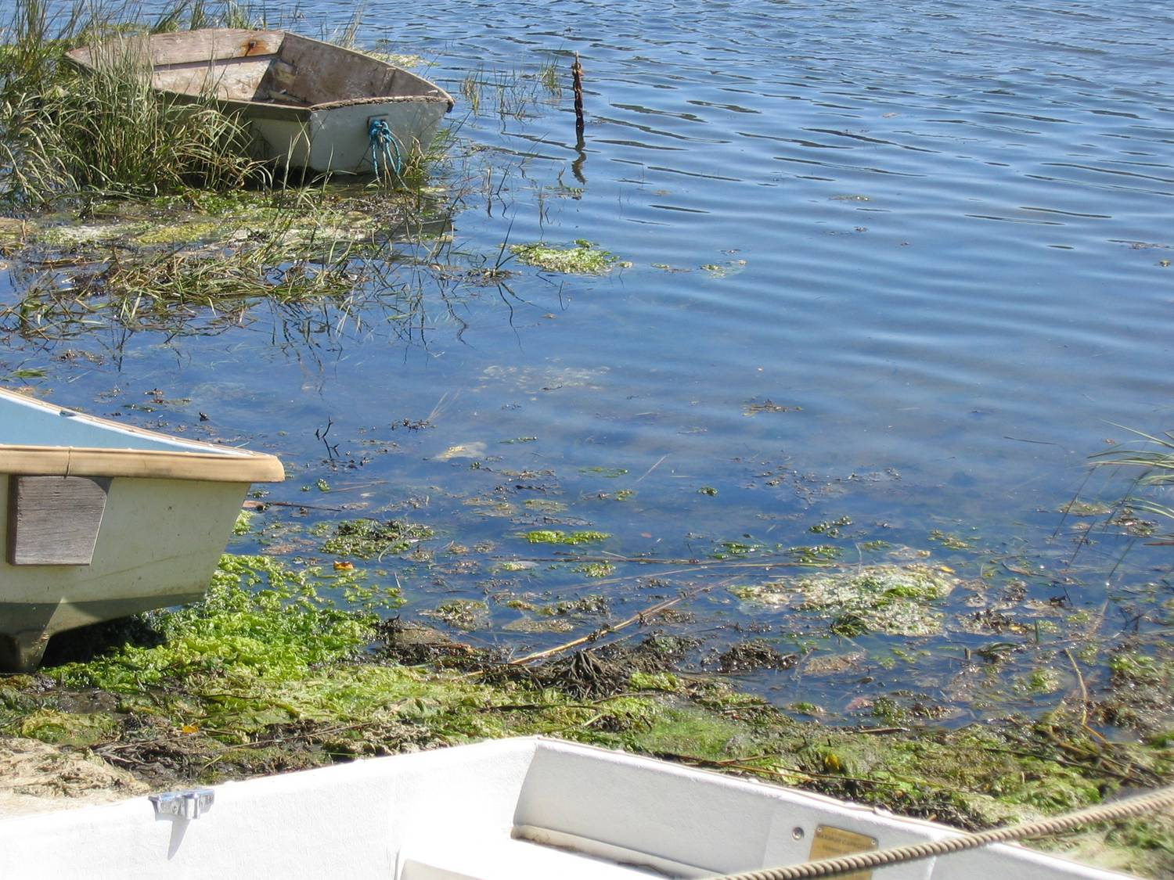
Effects of Excess Nitrogen
Algae Blooms
Loss of Eelgrass
Increased Macro-Algae
Low Dissolved Oxygen
Organic Enrichment of Sediments
Lack of Plant & Animal Diversity
Fish Kills
Notes:
In coastal systems Nitrogen is the limiting nutrient
Acting like a fertilizer, increasing productivity in the waterbody
Indicators of excess nitrogen include…..

Slide 16
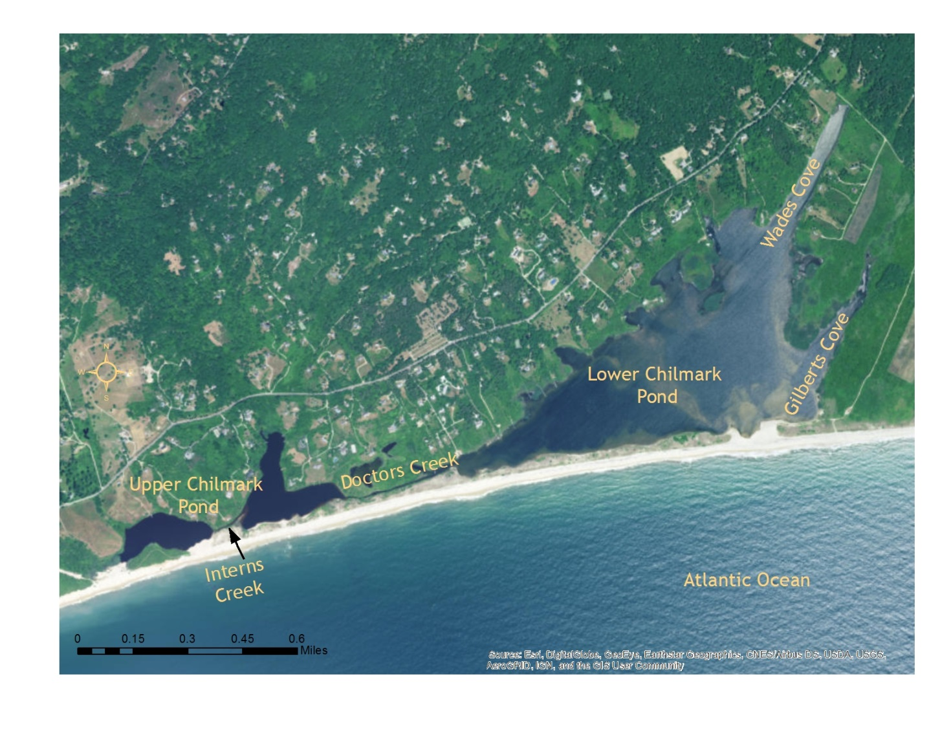
CHILMARK POND Embayment system
Notes:
The Chilmark Pond Embayment System consists of a 178-241 acre (depending on the water level in the pond) coastal salt pond.
The Chilmark Pond Embayment System is a complex coastal open water embayment comprised of a large main basin (lower Chilmark) and multiple sub-embayments.
The system is maintained as an estuary by the periodic breaching of the barrier beach with a single temporary inlet. This great salt pond is opened to tidal exchange by excavating a trench through the barrier beach seasonally as the water levels in the pond rise sufficiently (by freshwater inflow) to provide sufficient hydraulic head to erode the desired channel to the sea.
Floodwater from the Atlantic Ocean enters the main basin of lower Chilmark Pond and circulates through channels and across flats making its way up into Wades Cove the primary tributary basin in this system) as well as into upper Chilmark Pond (west), which is connected to lower Chilmark Pond via Doctor's Creek, a narrow channel .
The western basin, upper Chilmark Pond, is currently fresh to slightly brackish and has been functionally separated from the estuary by coastal processes.
The absence of continuous tidal exchanges between the estuary and Atlantic Ocean allows for a greater increase in nitrogen level than in similar sized open estuaries per unit of watershed loading, which results in increased sensitivity of this system to watershed nitrogen loading compared to open tidal systems.

Slide 17
Watershed Delineations
Notes:
The map shows the MEP delineated watersheds. The delineated contributory watershed includes 3,137 acres and 5 subwatersheds which were delineated for estimation of groundwater flows and nutrient export . The MEP team has estimated a total groundwater flow for the system of 25,354 m³/day.
For the MEP analysis, the Chilmark Pond estuarine system was partitioned into two general sub-embayment groups: 1) the eastern main basin including Wades Cove and Gilberts Cove and 2) the tributary western sub-basin (upper Chilmark Pond)

Slide 18
Water Quality Sampling Stations
in Chilmark Pond Estuarine System
5 years of data between 2003-2005 and 2010,2012
Target Threshold = 0.50 mg/L
Notes:
Map of water quality Monitoring stations used to gather data for the MEP tech report modeling and to develop the TMDL
The TMDL for total N for the ChilmarkPond estuarine system is based primarily on data collected, compiled and analyzed by University of Massachusetts Dartmouth’s School of Marine Science and Technology (SMAST) Coastal Systems Program and the town of Chilmark and the Martha’s Vineyard Commission, as part of the Massachusetts Estuaries Project (MEP). The data were collected over a study period from 2003 through 2005 and 2010,2012, a period which will be referred to as the “present conditions” in the TMDL report, since it contains the most recent data available.
Sentinel "station" is the average of the 5 long-term monitoring stations. The average was selected because given the relatively long periods between openings, dispersion and wind driven mixing result in a relatively uniform total nitrogen concentration throughout the estuary. In addition, the benthic animal community is also generally uniform in numbers of organisms and species composition .
The MEP also examined the hydrodynamics of the system.
The relatively short flushing time of 2.3 days for the entire Pond system, “provides some confidence that the temporary channel allows enough exchange to significantly improve water quality during a typical breach event”

Slide 19
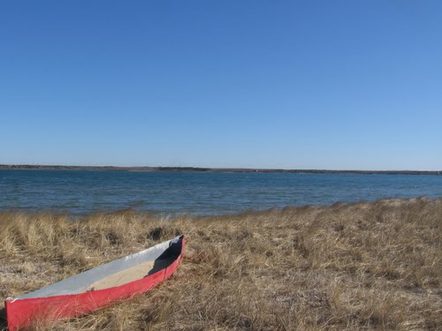
The primary ecological threat to the Chilmark Pond Estuarine System is degradation resulting from nutrient enrichment.
Impairments:
Elevated nutrients
Low dissolved oxygen levels
Slightly elevated chlorophyll-a levels
Benthic habitat degradation.
Notes:
The primary ecological threat to the Chilmark Pond Estuarine System is degradation resulting from nutrient enrichment, chiefly nitrogen.
Chilmark Pond estuary is particularly vulnerable to the effects of nutrient enrichment from the watershed, due to its very limited tidal exchange and that circulation is mainly through wind driven mixing in the small tributary sub-embayments. In particular, the Chilmark Pond Estuary is subject to cultural eutrophication from nitrogen enriched groundwater and surface water flows and runoff from its watershed.
Since there is no record of eelgrass in this estuary in recent
decades, the impairment of concern is that of benthic animal habitat (Table VIII-1).
Along with water quality sampling, MEP looked at eel grass habitat
At present, given moderate levels of watershed nitrogen loading and limited periodic tidal
exchange and the nitrogen, chlorophyll and oxygen levels within the pond basins (2000-2012), it
can be concluded that Chilmark Pond is not presently supportive of eelgrass beds and has not supported eelgrass habitat for at least 50 years.
Given that the pond's water quality is controlled in significant part by the amount of induced tidal
flushing, it is likely that the Pond has had negligible eelgrass habitat for the past century.

Slide 20
Contributions of All Nitrogen Sources to Chilmark Pond Estuarine System
Notes:
So what is contributing to all this nitrogen.
Land-use and wastewater analysis found that approximately 46% of the controllable watershed nitrogen load (system-wide) was from agricultural activity (animals and fertilizers) while approximately 41% was from septic systems.
however,
Septic systems are the largest source of controllable nitrogen watershed load in East, or Lower, Chilmark Pond representing 64% and In West, or Upper, Chilmark Pond agriculture (animals and fertilizers) is the largest source of controllable watershed nitrogen load representing 61% of the total controllable load
However, atmospheric deposition is not considered a locally controllable sources of N.
Local control load represents only those sources that can potentially be under local regulatory control.
It is important to note that the analysis of future nitrogen loading (build-out) to the Chilmark Pond estuarine system focuses upon additional shifts in land-use from forest/grasslands to residential and commercial development. However, the MEP analysis indicates that significant increases in nitrogen loading can occur under present land-uses, due to shifts in occupancy, shifts from seasonal to year-round usage and increasing use of fertilizers. Therefore, watershed-estuarine nitrogen management must include management approaches to prevent increased nitrogen loading from both shifts in land-uses (new sources) and from loading increases of current land-uses.
____________________
The Dukes Soil Conservation District (DSCD) evaluated the agricultural portion of the Tisbury Great Pond Massachusetts Estuaries Project (MEP) nitrogen load. The nitrogen from agricultural sources has been determined to be more than 40 percent of the total load on adjacent surface waters, exceeding wastewater sources. The substantial agricultural source is unique to the watersheds so far evaluated under MEP.
The study will carry out a survey of all farmers in the watershed. The goal is to determine the nutrient budgets for all farms within the watershed. In turn, the survey results will confirm or correct the MEP study’s nutrient-usage figures for both applied fertilizer and livestock waste, identify options to reduce nutrient sources where possible, and provide technical and financial resources to farm operators through the Natural Resource Conservation Service (NRCS) to reduce or eliminate sources.

Slide 21
Present Nitrogen Concentrations and Sentinel Station Target Threshold Nitrogen Concentrations
Sub-embayment | Station | Mean Observed Nitrogen Concentration (mg/L) | Target Threshold Nitrogen Concentration (mg/L)
Chilmark Pond East |  | 0.61 | 0.50
Chilmark Pond West |  | -- | --
Notes:
Mean observed nitrogen concentration is the average of 2004 data, ranges show the upper to lower regions (highest-lowest) of an sub-embayment.
Individual yearly means and standard deviations in Table VI-1.
For restoration of the Chilmark Pond Embayment System, the primary nitrogen
threshold at the "sentinel station" will need to be achieved. At the point that the threshold
level is attained at the sentinel station, water column nutrient concentrations will also be at a
level that will be supportive of healthy infaunal communities. The results of the Linked
Watershed-Embayment modeling are used to ascertain that when the nitrogen threshold is
attained, TN levels in the regions associated with the primary criteria of healthy infauna are
also within an acceptable range.
After characterizing present conditions and nutrient loads, The MEP conducts a nitrogen threshold analysis.
This graph shows the average total N concentrations from present (observed) loading from 2004 and the Target to be achieved
Restoration of impaired infaunal habitat is the restoration goal. Infaunal animal habitat is a critical resource to the Chilmark Pond Estuary and estuaries in general. Since there are no unimpaired infaunal animal habitat areas remaining in the Chilmark Pond Estuary, comparisons to the soft bottom basins of other nearby estuarine systems were relied upon for setting the nitrogen threshold for healthy infaunal habitat at a nitrogen level of TN <0.5 mg TN L- 1.
Present TN levels within the Chilmark Pond Estuary during summer are ~0.74 mg TN L-1, consistent with the observed lack of eelgrass beds and impaired benthic animal habitat. Based upon comparisons to other systems, the current TN level within the Chilmark Pond Estuary, the periodic oxygen depletions and phytoplankton blooms, it appears that a water column nitrogen threshold for the Chilmark Pond Estuary of 0.50 mg TN L-1 is required for restoration. All habitat metrics indicate a moderate to moderate/significant level of habitat impairment (Table VIII-1). While the TN level is significantly above the threshold (0.74 versus 0.5 mg TN L-1) the system is still supporting a productive if clearly impaired benthic animal community.
To restore benthic habitat, load reduction focused on lowering average TN levels of stations with the main basin to 0.50 mg/L during the summer months, when benthic regeneration and algae production is greatest. This goal was achieved by reducing the watershed loading to the pond and assuming the pond is breached three times a year. Watershed loading was reduced from present conditions until the combined time averaged TN concentration would remain below 0.50 mg/L during a 120-day period during the summer months. The threshold modeling assumptions include a successful spring breach, which remains open for 8 days and lowers the average pond TN concentration to 0.33 mg/L. The Pond is also allowed to be closed for 120 days, which allows the time for the water level in the pond to rise.

Slide 22
The Total Maximum Daily Loads (TMDL)
Sub-embayment | Target Threshold Watershed Load¹ (kg N/day) | Atmospheric Deposition (kg N/day) | Sediment Flux Net² (kg N/day) | TMDL³ (kg N/day)
Lower Chilmark Pond | 4.255 | 3.260 | 0 | 7.515
Upper Chilmark Pond | 10.540 | 0.655 | 0 | 11.195
System Total | 14.795 | 3.915 | 0 | 18.71
Notes:
This graph shows the watershed load that will achieve the identified target threshold N concentration at the identified sentinel station.
Based on the MEP work and their resulting Technical report, the Department has determined the Total maximum Daily Loads ( TMDL ) of TN that will meet the target threshold concentrations 0.50 kg/ day.
The sum of target threshold watershed load, sediment load and atmospheric deposition load gives you the TMDL.
________________
¹ Target threshold watershed load is the load from the watershed needed to meet the embayment target threshold nitrogen concentration identified in Table 3.
² Projected sediment N loadings obtained by reducing the present loading rates (Table 5) proportional to proposed watershed load reductions and factoring in the existing and projected future concentrations of PON. Negative fluxes set to zero.
³ Sum of target threshold watershed load, atmospheric deposition load and sediment (benthic) load.

Slide 23
Total Watershed Nitrogen Load, Target Threshold Load, and Percent Reduction Needed to Meet the Target Threshold Load
Sub-embayment System | Present Total Watershed Load¹ (kg/day) | Target Watershed Load² (kg/day) | Percent Watershed Load Reductions Needed to Achieve Target
Chilmark - East | 5.485 | 4.255 | 22.4%
Chilmark - West | 11.614 | 10.540 | 9.2%
Total | 17.099 | 14.795 | 13.5%
Notes:
Finally, SMAST runs the linked watershed embayment model using different watershed nitrogen loading rates to determine the loading rate that will achieve the target threshold concentration at the sentinel station.
differences between the modeled nitrogen load required to achieve the target concentration and the present watershed load represents the management goals for restoration and protection of the embayment.
To meet the TMDL, a 13.5% reduction of the total watershed nitrogen load is necessary
*From Tables ES-2and VIII-3 in the MEP Technical Report.
(1) Composed of combined natural background, fertilizer, runoff, and septic system loadings.
(2) Target threshold watershed load is the load from the watershed needed to meet the embayment threshold concentration identified in Table ES-1.
(3) Projected future flux (present rates reduced approximately proportional to watershed load reductions).
(4) Sum of target threshold watershed load, atmospheric deposition load, and benthic flux load.
Given the relatively low watershed nitrogen load to the Chilmark Pond estuarine basins, it may be difficult to lower TN levels by ~0.2 mg L-1 to meet the threshold. This is consistent with the MEP measurements of periodically opened basins and systems with significantly restricted
tidal flows, such as Rushy Marsh Pond, Farm Pond. In such cases increases in the amount, duration or frequency of tidal exchange, generally through openings is needed to lower the level of nitrogen enrichment and restore the impaired habitats. This will likely be the case for
Chilmark Pond, as well.

Slide 24
Present Septic System Loads and the Loading Reductions that would be Necessary to Achieve the TMDL by Reducing Septic System Loads Alone
Sub-embayment | Present Attenuated Septic N Load (kg/day) | Threshold (kg/day) | Threshold Septic Load % Change
Lower Chilmark Pond | 3.074 | 1.884 | 38.7%
Upper Chilmark Pond | 3.068 | 1.995 | 35.0%
Total | 6.142 | 3.879 | 36.8%
Notes:
The above modeling results provide one scenario of achieving the threshold level for the sentinel site within the estuarine system. This example does not represent the only method for achieving this goal. The town of Chilmark is encouraged to evaluate other load reduction scenarios and take any reasonable steps to reduce the controllable N sources.
This goal was achieved by reducing the watershed loading to the pond and assuming the pond is breached three times a year. Watershed loading was reduced from present conditions until the combined time averaged TN concentration would remain below 0.50 mg/L during a 120-day period during the summer months. The threshold modeling assumptions include a successful spring breach, which remains open for 8 days and lowers the average pond TN concentration to 0.33 mg/L. The Pond is also allowed to be closed for 120 days, which allows the time for the water level in the pond to rise. To achieve the threshold a 30% septic reduction from present conditions was required in the septic load to the pond. This is but one example of a loading reduction that can achieve the threshold assuming the above mentioned breaching criteria can be achieved.
All other watershed sources, including agricultural loads, were not reduced for this scenario.

Slide 25
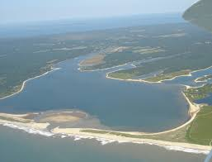
Modeling the Options for Achieving the Target Threshold Nitrogen Concentration
Conventional Approaches:
      Sewering/denitrifying systems
      Stormwater controls
      Fertilizer use reduction bylaws
Non-traditional Approaches:
      Improved flushing
      Enhanced natural attenuation
      Aquaculture
Notes:
The MEP Linked model can explore combinations of conventional and non-traditional approaches to reduce the watershed N load and can be used to illustrate how changes in land use will affect the nutrient load. It is important to note that load reductions can be produced through a variety of strategies.
For example, the model can illustrate how much the nitrogen load will drop if flows from on-site wastewater systems decrease or if fertilizer use is reduced or if tidal flushing is increased.
It has been suggested by some in town to improve hydraulics by dredging the pond. This wouldl require several state and federal permits. This would require new modeling.
By reducing the agricultural N load by just 10%, the need for alternative wastewater solutions could be reduced in some areas. The town of Chilmark may consider requesting an additional model run from SMAST that evaluates a scenario that includes recommendations for reductions in agriculture N loads, as well as, septic loads from the various subembayments. This will help focus agricultural BMP implementation activities to areas that will most effectively reduce N loads.

Slide 26

Comprehensive Water Resource Management Planning (CWRMP)
Based on acceptable nitrogen loading
Identifies wastewater management options
Schedules implementation
Watershed-wide approach
Notes:
Once the Technical Report and TMDL are complete, communities decide through Comprehensive Water resources Management Planning (CWRMP) how best to implement the TMDL in order to achieve the desired water quality goals.
The TMDL serves as the regulatory and technical basis for developing comprehensive water resources management plans .
MassDEP reviews and approves a community's CWMP, and makes subsequent permitting decisions based on its approved Plan.
Local officials can explore other loading reduction scenarios through additional modeling as part of their CWRMP.
The town of Chilmark is urged to work together to meet the target threshold N concentrations by reducing N loadings from any and all sources, through whatever means are available and practical, using both technical and planning approaches.

Slide 27
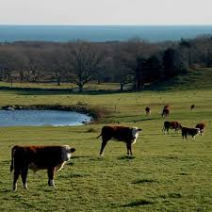
Technical Approaches
Enhanced Wastewater Treatment
Storm Water Runoff Control & Treatment
Flushing Enhancements
Enhanced Nitrogen Attenuation
Permeable Reactive Barriers
Notes:
technical approaches include
Reducing the loadings from on-site subsurface wastewater disposal systems by
Sewering
Treatment with N removal technology
Advanced septage treatment or nitrogen reducing on-site systems
Permeable reactive barriers
Septic system loads from private residences is the second largest contributor to the controllable N load (41%), therefore as part of the Comprehensive Water Resources Management Plan (CWRMP) the town should assess the most cost-effective options for achieving the target N watershed loads, including but not limited to, treatment for N control of sewage and septage at either centralized or de-centralized locations and denitrifying systems for all private residences.
Also BMPS to reduce N loadings from fertilizers and runoff.
Enhanced attenuation
Shellfish beds (oysters)
Permeable Reactive Barriers
Floating constructed wetlands
and
Breaching the barrier beach. More timely and longer pond openings

Slide 28

Planning Approaches
Local Zoning (guided development)
Bylaws
Financing Opportunities
State Revolving Fund (SRF) can cover planning & construction
USDA Rural Development Grants
SRF Points for a Wastewater Management District
Notes:
Planning approaches include local zoning and bylaws for land use and building controls, fertilizer use controls, and stormwater controls.
The towns have passed fertilizer use regulations. Local zoning and bylaws can implement such things as land use and building controls, fertilizer use cntrols and stormwater controls.
Dukes County Conservation District, is conducting a survey of all farms in the Tisbury Great Pond watershed and studying the nitrogen load from agricultural uses.
There are opportunities thru SRF funding and grants for creative financing of these implementation activities
Regional cooperation enhances point scores and opportunities for funding through SRF.
Appropriateness of any of the implementation approaches depends on local conditions and are determined on a case by case basis using adaptive management
funding priority for Section 319 grants and SRF loans will be given to watershed cleanup projects that advance TMDL program requirements.

Slide 29

MassDEP
Implementation Guidance Manual
  Companion to technical reports
  Provides an overview of tools that can be used
  Looks at technical and institutional options
https://www.mass.gov/guides/the-basics-of-total-maximum-daily-loads-tmdls#tmdls-and-permitting
https://www.mass.gov/files/documents/2019/02/21/chilmark-pond-draft-tmdl-2019-03.pdf
Notes:
MassDEP realizes that an adaptive management approach may be used to observe implementation results over time and allow for adjustments b
based on those results.
https://www.mass.gov/guides/the-basics-of-total-maximum-daily-loads-tmdls#tmdls-and-permitting

Slide 30
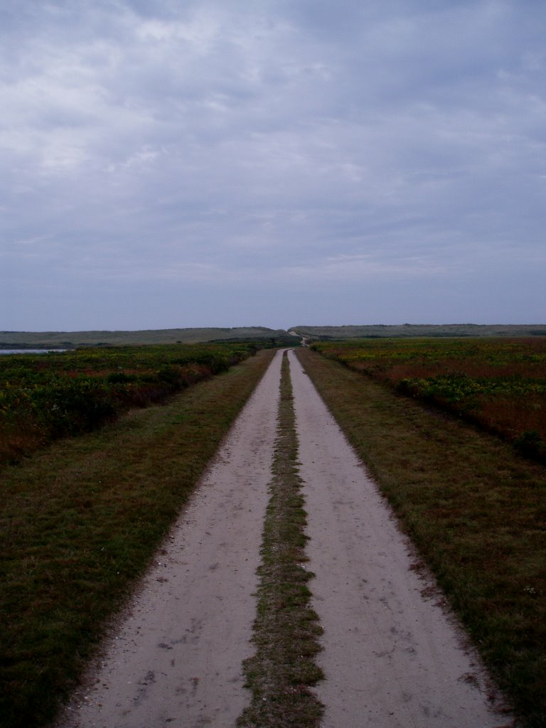
Where Do We Go From Here?
Public/Towns: Submit comments to DEP on draft TMDLs by May 3, 2019
DEP: Revise TMDL Document
  (based on public input)
DEP: Submit TMDL to EPA
Towns: Continue Comprehensive Water Resources Management Planning
Notes:
Public comment on the TMDL will be accepted up until COB May 3, 2019

Slide 31
Questions/Comments on TMDLs
Written comments due by Friday,
May 3, 2019 at 5:00 pm
Send to:
barbara.kickham @mass.gov
MassDEP
Division of Watershed Management
8 New Bond Street
Worcester, MA 01606
Attention: Barbara Kickham
Notes:
MassDEP will consider all comments and the Draft TMDL Reports will be revised as appropriate prior to submittal to EPA Region 1 for approval. All comments (written and electronic) should refer to the specific report number(s)
Chilmark Pond Estuarine System Total Maximum Daily Load for Total Nitrogen (Control #451.0 );
and must be received by 5:00 p.m. on Friday, may 3, 2019

